Slide 1


Slide 2


Slide 3


**Breast Cancer Risk Prediction using Machine Learning**
Presented by: Rahul Mishra
Domain: Data Science & Machine Learning
Tools: Python, Pandas, Scikit-Learn, K Means, DBSCAN, Machine Learning, Random forests., NUMPY, linear regression.

Slide 4
Introduction : Breast Cancer
Introduction
Breast cancer is a disease in which cells in the breast tissue divide and grow uncontrollably, often forming a tumor that can be felt as a lump or detected through medical imaging. Although it primarily affects women, men can also develop it in rare cases. The condition typically originates either in the milk ducts, known as ductal carcinoma, or in the milk-producing glands, known as lobular carcinoma. When cancer cells remain confined to their point of origin, the condition is considered non-invasive, whereas invasive breast cancer occurs when those cells break out and spread into adjacent breast tissue or nearby lymph nodes.

Slide 5
Problem Statement
The problem statement of this project is to analyze breast cancer patient data and predict the patient’s survival status using clinical and biological features.
The goal is to identify important factors that affect patient outcomes and help in early diagnosis and better treatment planning.

Slide 6
Project Objectives
The main objective of this project is to analyze breast cancer patient data and identify the important clinical factors that may be related to patient outcomes. The project uses patient information such as age, tumor size, tumor stage, hormone receptor status, and treatment details. Using these features, we aim to build a machine learning classification model that can predict the patient's vital status, whether the patient is Alive or Died. This project also helps us understand patterns in the data and identify factors that may be associated with patient survival outcomes.

Slide 7
Dataset Overview
📊 Dataset Overview (Paste in PPT)
Dataset Name:
Breast Cancer Dataset
Source:
Publicly available medical dataset (used for academic and learning purposes)
Number of Records:
Approximately 2,000 patient records
Number of Features:
Around 30 input features + 1 target variable
Target Variable:
Patient’s Vital Status
0 → Living
1 → Dead of Disease
Type of Data:
Structured, numerical and categorical data
Problem Type:
Binary Classification Problem
Purpose of Dataset:
To analyze patient clinical information and predict breast cancer patient survival outcome.

Slide 8
Dataset Overview
Performed exploratory data analysis to understand the dataset
Univariate analysis performed using bar charts and count plots
Handled null values : Missing numerical values were filled using median / Missing categorical values were filled using mode
Exploratory Data Analysis (EDA)
Encoded target variable
Removed irrelevant columns
Applied train-test split
Final dataset ready for model training

Slide 9
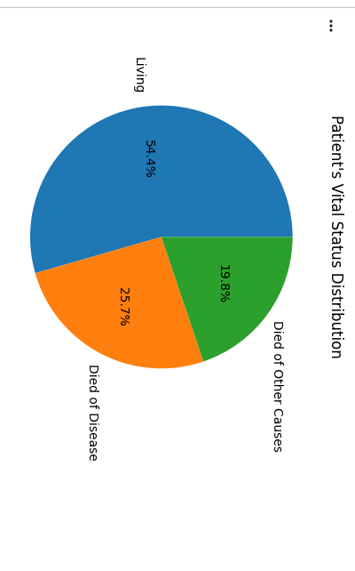
PIE CHART Patient’s Vital Status (Target Variable)

Slide 10
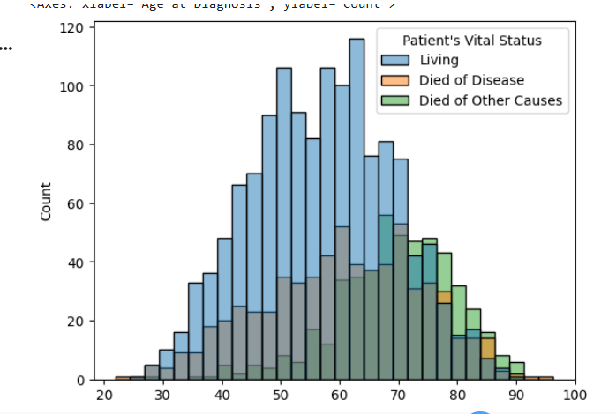

Slide 11
neering
Features Used
Age at Diagnosis
Tumor Size
Tumor Stage
Cellularity
Chemotherapy
Hormone Therapy
Radio Therapy
ER Status
PR Status
HER2 Status
🎯 Target Variable
Patient's Vital Status — Alive / Died

Slide 12
Model Performance
Models evaluated using accuracy, precision, recall, and F1-score
Random Forest performed better compared to Logistic Regression

Slide 13
Models Used
Logistic Regression (Baseline model).
*Random Forest Classifier .
*Cross Validation
Cross validation was applied to evaluate model stability
It helped in reducing overfitting
Improved reliability of the Random Forest model

Slide 14
Conclusion
In this project, machine learning models were used to predict breast cancer patient survival status.
Data preprocessing and exploratory data analysis helped in understanding important patterns in the dataset.
Missing values were handled using median and mode techniques.
Multiple models were trained and evaluated using performance metrics.
Random Forest Classifier performed better and was selected as the final model.
The results show that machine learning can assist in early risk prediction and decision support

Slide 15
Limitations & Future Scope
Limitations
Dataset limited to available records
Model performance may vary on unseen data
Future Scope
Use larger dataset
Try advanced models
Deploy as a web application

Slide 16

THANK YOU

